Slide 1
CNN (Convolutional Neural network)

Slide 2
Objectives
Understand the inspiration behind CNN and learn the CNN architecture
Learn the convolution operation and its parameters

Slide 3

What is a convolutional neural network (CNN)?

Slide 4
Recent trend
Increasing popularity of social media in past decade.
Image and video processing tasks have become very important
FNN could not scale up to image and video processing tasks
CNN specifically tailored for image and video processing tasks

Slide 5
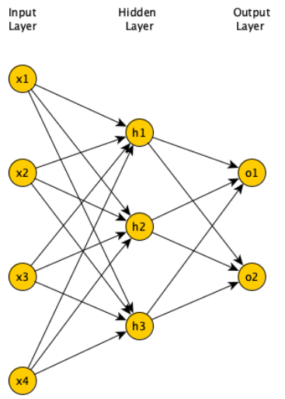
Feedforward neural networks (FNN)
In FNN all nodes in a layer connected to all nodes in next layer
Each connection has a weight, must be learned by learning algorithm

Slide 6
Limitations of FNN
If input is 64 pixel by 64 pixel grayscale image.
Each grayscale pixel represented by 1 value, usually between 0 to 255
Where 0 is black, 255 is white, and values in between are shades of gray
Since each grayscale pixel represented by 1 value, we say channel size is 1
Image represented by 64 x 64 x 1 = 4,096 values (rows x columns x channels).
Hence, input layer of FNN has 4096 nodes
Lets assume next layer has 500 nodes.
Since FNN fully connected, we have 4,096 x 500 = 2,048,000 weights

Slide 7

Limitations of FNN
For complex problems, we need multiple hidden layers in our FNN
Compounds the problem of having many weights
Having too many weights
Makes learning more difficult as dimension of search space is increased
Makes training more time/resource consuming
Increases the likelihood of overfitting
Problem is further compounded for color images
Each pixel in color image represented by 3 values (RGB color mode)
Since each pixel represented by 3 values, we say channel size is 3
Image represented by 64 x 64 x 3 = 12,288 values (rows x columns x channels)
Number of weights is now 12,288 x 500 = 6,144,000

Slide 8

Limitations of FNN
Clear that FNN cannot scale to larger images (Too many weights)
Another problem with FNN
2D image represented as 1D vector in input layer
Any spatial relationship in the data is ignored

Slide 9
Architecture of CNN
Layers
Input layer
Convolution layer
Pooling layer
Fully connected layer

Slide 10
Input layer
Example input a 28 pixel by 28 pixel grayscale image
Unlike FNN, we do not “flatten” the input to a 1D vector
Input is presented to network in 2D as 28 x 28 matrix
This makes capturing spatial relationships easier

Slide 11
Convolution layer
Composed of multiple filters (kernels)
Filters for 2D image are also 2D
Suppose we have a 3 by 3 filter (9 values in total)
Values are randomly set to 0 or 1
Convolution: placing 3 by 3 filter on the top left corner of image
Multiply filter values by pixel values, add the results
Move filter to right one pixel at a time, and repeat this process
When at top right corner, move filter down one pixel and repeat process
Process ends when we get to bottom right corner of image

Slide 12
3 by 3 Filter

Slide 13
Convolution operator parameters
Filter size
Padding
Stride
Dilation
Activation function

Slide 14
Filter size
Filter size can be 5 by 5, 3 by 3, and so on
Larger filter sizes should be avoided
As learning algorithm needs to learn filter values (weights)
Odd sized filters are preferred to even sized filters
Nice geometric property of all input pixels being around output pixel

Slide 15
Padding
After applying 3 by 3 filter to 4 by 4 image, we get a 2 by 2 image – Size of the image has gone down
If we want to keep image size the same, we can use padding
We pad input in every direction with 0’s before applying filter
If padding is 1 by 1, then we add 1 zero in every direction
If padding is 2 by 2, then we add 2 zeros in every direction, and so on

Slide 16
3 by 3 filter with padding of 1

Slide 17
Stride
How many pixels we move filter to the right/down is stride
Stride 1: move filter one pixel to the right/down
Stride 2: move filter two pixels to the right/down

Slide 18
Dilation
When we apply 3 by 3 filter, output affected by pixels in 3 by 3 subset of image
Dilation: To have a larger receptive field (portion of image affecting filter’s output)
If dilation set to 2, instead of contiguous 3 by 3 subset of image, every other pixel of a 5 by 5 subset of image affects output

Slide 19
Activation function
After filter applied to whole image, apply activation function to output to introduce non-linearlity
Preferred activation function in CNN is ReLU
ReLU leaves outputs with positive values as is, replaces negative values with 0

Slide 20
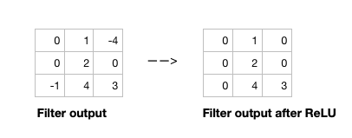
Relu activation function

Slide 21
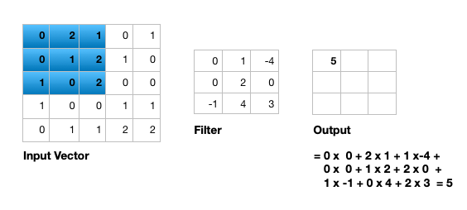
Single channel 2D convolution

Slide 22
Change channel size
Output of a multi-channel 2D filter is a single channel 2D image
Applying multiple filters results in a multi-channel 2D image
E.g., if input image is 28 x 28 x 3 (rows x columns x channels)
We apply a 3 x 3 filter with 1 x 1 padding, we get a 28 x 28 x 1 image
If we apply 15 such filters, we get a 28 x 28 x 15
Number of filters allows us to increase or decrease channel size

Slide 23
Pooling layer
Pooling layer performs down sampling to reduce spatial dimensionality of input
This decreases number of parameters
Reduces learning time/computation
Reduces likelihood of overfitting
Most popular type is max pooling
Usually a 2 x 2 filter with a stride of 2
Returns maximum value as it slides over input data

Slide 24
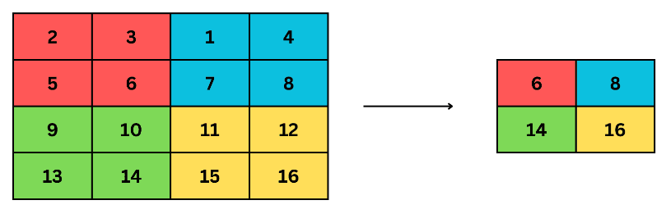
Max Pooling layer

Slide 25
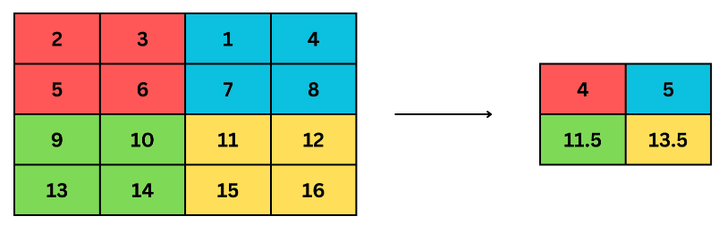
Average Pooling
(2+3+5+6)/4
= 4
(1+4+7+8)/4
= 5
11.5
(9+10+13+14)/4
= 11.5
(9+10+13+14)/4
= 11.5

Slide 26
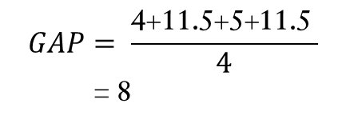
Global Average Pooling
11.5
$$GAP= \frac{\text{4+11.5+5+1}\text{1}\text{.5 }}{4}$$
= 8

Slide 27
Fully connected layer
Last layer in a CNN
Connect all nodes from previous layer to this fully connected layer
Which is responsible for classification of the image

Slide 28
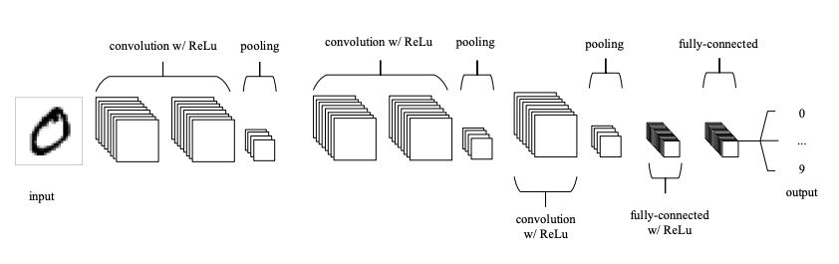
An example CNN

Slide 29
An example CNN
A typical CNN has several convolution plus pooling layers
Each responsible for feature extraction at different levels of abstraction
E.g., filters in first layer detect horizontal, vertical, and diagonal edges
Filters in the next layer detect shapes
Filters in the last layer detect collection of shapes
Filter values randomly initialized, learned by learning algorithm
CNN not only do classification, but can also automatically do feature extraction
Distinguishes CNN from other classification techniques (like Support Vector Machines)

Slide 30
MNIST dataset
MNIST dataset of handwritten digits
Composed of training set of 60,000 and test set of 10,000 images
Digits have been size-normalized/centered in a fixed-size image (28 by 28 pixels)
Images are grayscale
Each pixel is represented by a number between 0 and 255
0 for black, 255 for white, and other values for shades of gray
MNIST dataset is a standard image classification dataset
Used to compare various Machine Learning techniques

Slide 31
Classification of MNIST images with CNN
We define a CNN and train it using MNIST dataset training data
Goal is to learn a model such that given image of a digit we predict the digit (0 to 9)
We then evaluate the trained CNN on test dataset and plot the confusion matrix

Slide 32
Thank you
Shukdev Datta
ML Engineer

